Slide 1
Progress report and next steps on the revision of the trade manuals
A journey of thousand miles
by
Vysaul Nyirongo (email: nyirongov@un.org)

Slide 2
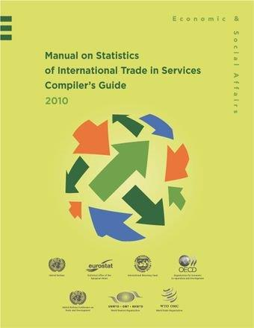
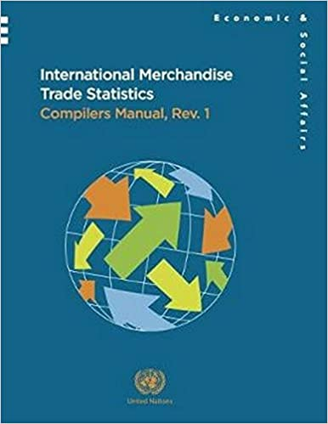
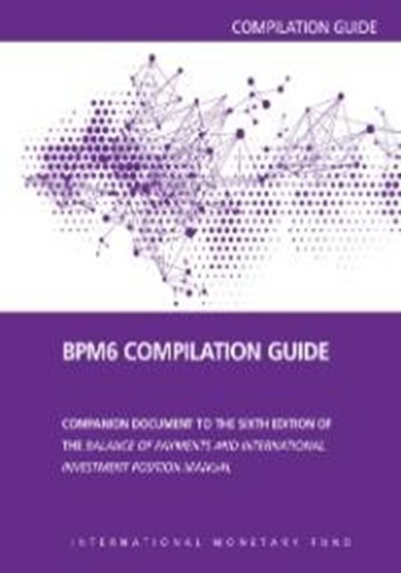
Manuals on international trade statistics

Slide 3
Background
Task Team on International Trade Statistics UN Committee of Experts on Business and Trade Statistics
Established in 2021:
First meeting in October 2021
Monthly meetings
Priorities:
Revising the international trade statistics manuals
Integration between trade and business statistics
Cross-cutting topics (e.g., GVC, digital trade)
Leadership, broad representation:
TT-ITS is led by Morocco and Portugal
Worldwide representations
Capacity-building (maturity model, trade data tools)
3

Slide 4
Research Agenda: Vertical and Horizontal integration
Vertical integration
Upstream harmonization of ITS with macroeconomic statistical frameworks, including BPM and SNA
Downstream integration with the various data sources, including customs, administrative and survey data
Horizontal integration
Globalization
Digitalization
Well-being
Sustainability
4

Slide 5
Work-flow Schematic for the life cycle of Guidance Notes and manual drafting
Revision process
GN drafted by
assigned authors
=> peer-reviewed by TT-ITS
Draft GNs reviewed by UNCEBTS
=> Approval
Global consultation including
experimentation and testing
Revision of GNs by original authors
=> Second round review
[Only if significant changes]
TT-ITS sends GN and recommendations to UNCEBTS
=> Approval
Manual/Compilation Guide Update
=> Approval by UNCEBTS
=> Global consultations
=> UNSC Endorsement

Slide 6
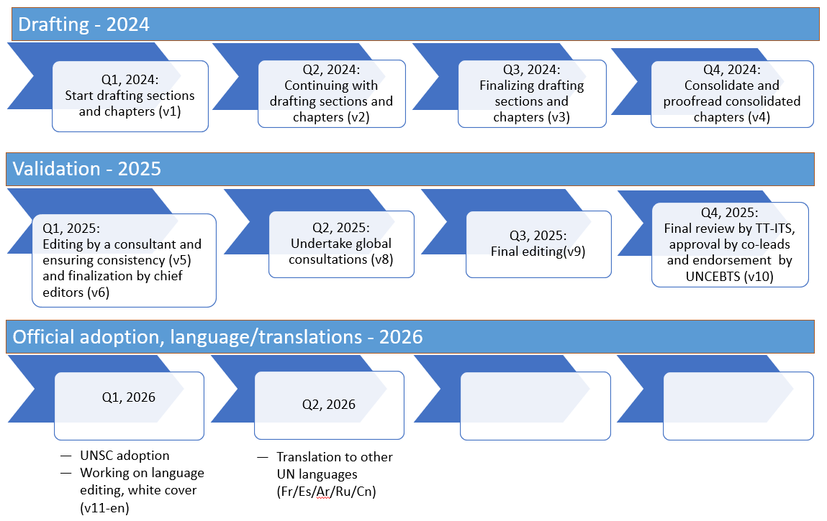
General Timeline – of IMTS and MSITS update
6

